Slide 1

ONC Interoperability Forum Improving Care Coordination between Acute and Post-Acute Care using FHIR
Beth Connor, RN- Centers for Medicare and Medicaid Services (CMS)
Dave Hill, MITRE
Michelle Dougherty, RTI International
August 21, 2019

Slide 2
Disclaimer
This presentation was current at the time it was published or uploaded onto the web. Medicare policy changes frequently so links to the source documents have been provided within the document for your reference.
This presentation was prepared as a service to the public and is not intended to grant rights or impose obligations. This presentation may contain references or links to statutes, regulations, or other policy materials. The information provided is only intended to be a general summary. It is not intended to take the place of either the written law or regulations. We encourage readers to review the specific statutes, regulations, and other interpretive materials for a full and accurate statement of their contents.

Slide 3
Acronyms in this Presentation
CMS – Centers for Medicare & Medicaid Services
DCPAC – Division of Chronic and Post-Acute Care
DEL – Data Element Library
FHIR- Fast Healthcare Interoperability Resources
HHA – Home Health Agency
HIS – Hospice Item Set
HIT – Health Information Technology
IMPACT – Improving Medicare Post-Acute Care Transformation Act
IRF – Inpatient Rehabilitation Facility
IRF-PAI – Inpatient Rehabilitation Facility Patient Assessment Instrument
LCDS – LTCH CARE Data Set
LOINC – Logical Observation Identifiers Names and Codes
LTCH – Long-Term Care Hospital
MDS – Minimum Data Set
OASIS – Outcome and Assessment Information Set
PAC – Post-Acute Care
SNF – Skilled Nursing Facility
SNOMED-CT – Systematized Nomenclature of Medicine - Clinical Terms
SPADEs – Standardized Patient Assessment Data Elements

Slide 4
Overview
Post-Acute Care Overview
IMPACT Act and the Data Element Library
PACIO Project
PAC Fast Healthcare Interoperability Resources (FHIR) Development

Slide 5
Why is Post-Acute Care Important?
Hospitalization
HHA (47.8%)
SNF (42.1%)
IRF (8.4%)
PAC (45%)
No PAC services (55%)
HHA Only (72.3%)
Acute (24.5%)
SNF (2.5%)
IRF (0.4%)
LTCH/ LTCH SN (0.2%)
LTCH/ LTCH SN (1.7%)
SNF Only (38.7%)
HHA (42.2%)
Acute (18.8%)
IRF (0.3%)
LTCH/ LTCH SN (0.1%)
Approximately 33,000 PAC Providers in the U.S. care for 6.9 million beneficiaries costing over $73.8 billion annually
After a hospitalization, 45% of patients required PAC services. HHA and SNFs were the most utilized services after a hospital admission
Of those patients that required HHA services after a hospital admission, 72.3% did not require any further services
Of those patients that required SNF services 38.7% did not require any further services but 42.2% transitioned to HHA.

Slide 6
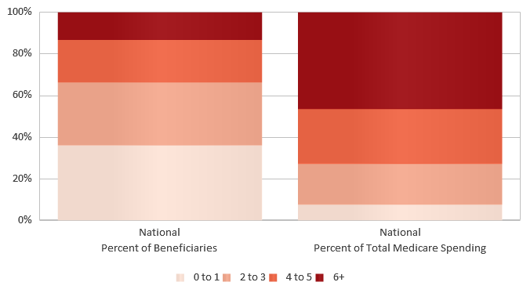
Distribution of Beneficiaries by Number of Chronic Conditions & Total Medicare Spending in 2015
Source: https://www.cms.gov/Research-Statistics-Data-and-Systems/Statistics-Trends-and-Reports/Dashboard/chronic-conditions-state/cc_state_dashboard.html
© 2018 The MITRE Corporation. All rights reserved
6

Slide 7
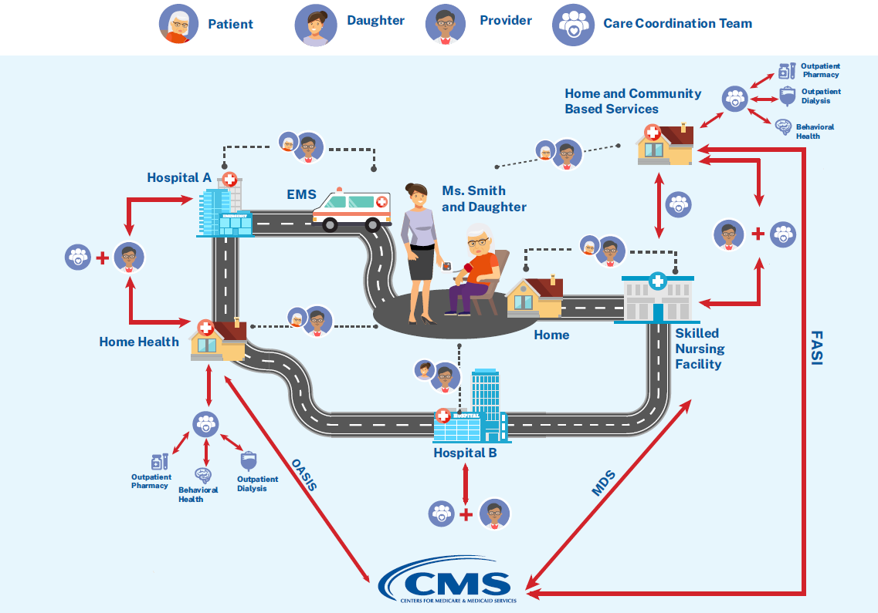
The Patient Story

Slide 8
Points of Failure
Poor communication across care providers, including outpatient
Medication discrepancies such as drug omissions during transitions of care are common
Multiple modes of information transmission are often used
Delays in PAC services can lead to adverse events and preventable readmissions
Redundant information collection creates inefficiencies and burden
Reliance on patient recall during periods of high stress
Recall of information can be unreliable
Patients may be unconscious, incapacitated, or otherwise unresponsive / unable to communicate information
Increased patient / family stress
Increased Cost and Provider Burden
Additional costs related to hospital stays from adverse events, readmissions
Additional administrative costs to locate, reconcile, and coordinate information
Longer length of stays and higher resource utilization

Slide 9
IMPACT Act of 2014
Bi-partisan bill passed on September 18, 2014, and signed into law October 6, 2014
The Act requires standardized patient assessment data elements (SPADES) for:
LTCHs: LCDS
SNFs: MDS
HHAs: OASIS
IRFs: IRF-PAI
The Act specifies that data “… be standardized and interoperable so as to allow for the exchange of such data among such post-acute care providers and other providers and the use by such providers of such data that has been so exchanged, including by using common standards and definitions in order to provide access to longitudinal information for such providers to facilitate coordinated care and improved Medicare beneficiary outcomes…”.
Improving Medicare Post-Acute Care Transformation (IMPACT) Act of 2014

Slide 10
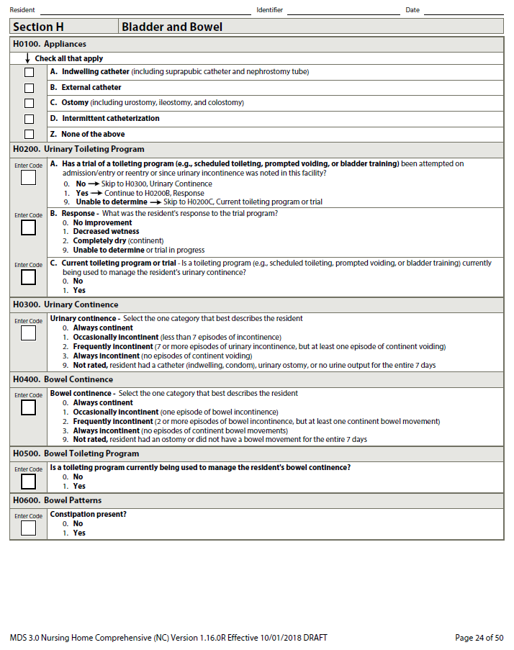
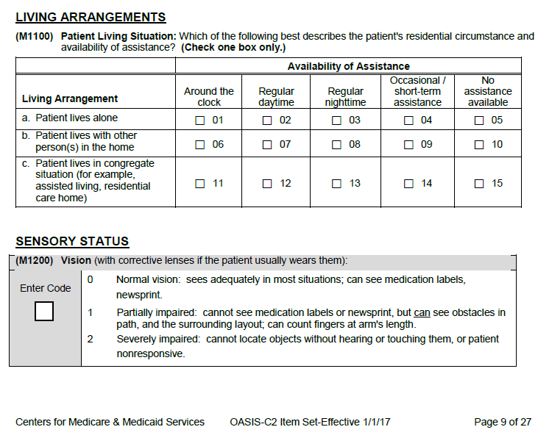
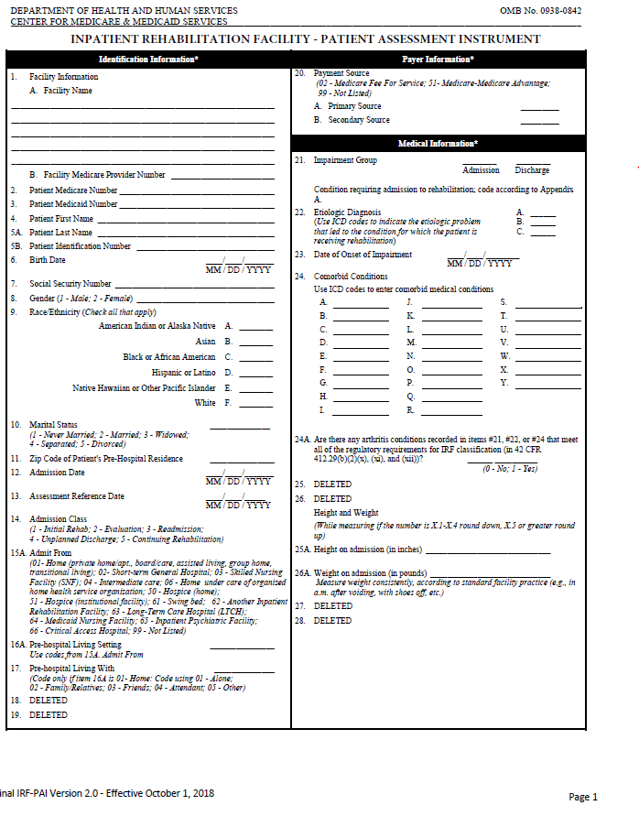
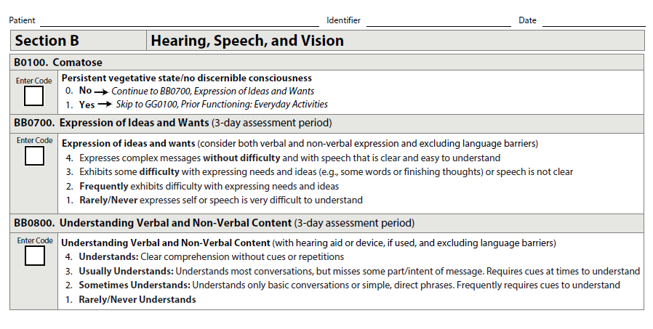

What are Post-Acute Care Assessments?
CMS PAC Assessments
LTCH Continuity Assessment Record & Evaluation (CARE) Data Set (LCDS)
Resident Assessment Instrument (RAI) Minimum Data Set (MDS)
Outcome and Assessment Information Set (OASIS)
IRF Patient Assessment Instrument (IRFPAI)
Hospice Item Set (HIS)*
OASIS C2
10
Notes:
*No IMPACT Act requirements; New Hospice assessment under development- expected implementation in 2023

Slide 11
PAC Assessment Content
Administrative Content
Patient Name
Date of Birth
Race/Ethnicity
Marital status
Admission/Discharge dates
Admit from/Discharged to locations
Reason for admission
Provider NPI, CCN, Medicaid Provider #
“SPADEs”
Function (e.g., self care and mobility)
Cognitive function (e.g., express & understand ideas; mental status, such as depression and dementia)
Special services, treatments & interventions (e.g., need for ventilator, dialysis, chemotherapy, and total parenteral nutrition)
Medical conditions and co-morbidities (e.g., diabetes, heart failure, and pressure ulcers)
Impairments (e.g., incontinence; impaired ability to hear, see, or swallow)
Other categories
Clinical Content
Diagnosis/medical conditions
Mental/Cognitive Status (memory, orientation, consciousness, delirium, mood, behavior)
Communication (express needs, understanding verbal/non-verbal content, hearing and vision)
Functional Status (Self-care/ADLs, Mobility, Use of assistive devices)
Bladder and Bowel continence
Falls
Pressure ulcers and other skin conditions
Surgery
Nutritional and swallowing status
Medication information
Special treatments, procedures & programs
Height and Weight
Patient preferences and goals of treatment
Pain
Vaccinations
Therapy- PT, OT, SLT
Living arrangements/support availability
Care planning

Slide 12
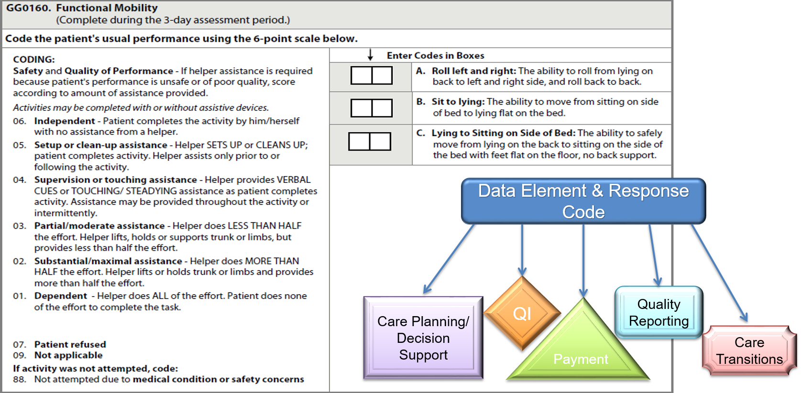
Data Elements: Standardization One Question → One Response: Many Uses

Slide 13
The Data Element Library
The (DEL) is a centralized resource for CMS assessment data elements (e.g. questions and response options), and their associated mappings to nationally accepted health information technology (IT) standards.
Use is optional
Supports provider exchange of electronic health information for better care coordination
Enables more seamless/less costly health information exchange
Reduces overall provider burden through use and exchange of health care data
Promotes high quality, personalized, efficient health care
Supports real-time, data driven, clinical decision making
Search and generate reports (assessment questions & response options, their attributes, and linked HIT standards)
No patient data
Visit the DEL here: https://del.cms.gov

Slide 14
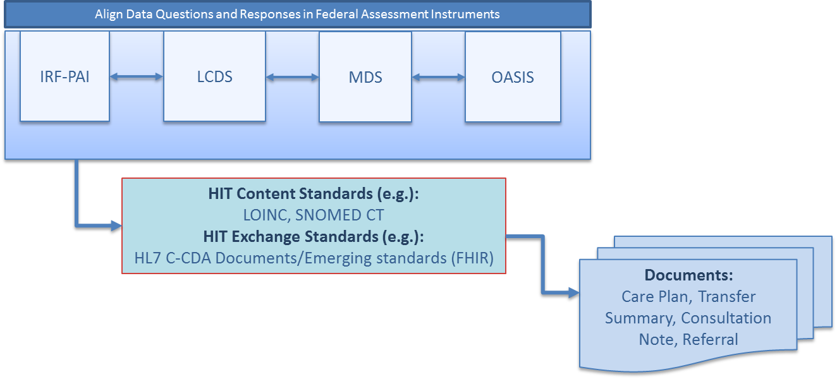
Making PAC Assessment Data Elements Standardized/Aligned and Interoperable
PAC Setting | CMS Assessment
Long-term Care Hospitals (LTCHs) | LTCH Continuity Assessment Record & Evaluation (CARE) Data Set (LCDS)
Skilled Nursing Facilities (SNFs) | Resident Assessment Instrument (RAI) Minimum Data Set (MDS)
Home Health Agencies (HHAs) | Outcome and Assessment Information Set (OASIS)
Inpatient Rehabilitation Facilities (IRFs) | IRF patient assessment instrument (IRF-PAI)
Hospices | Hospice Item Set
Relevant interoperable assessment data (such as functional status, cognitive status, etc.) can be used to populate documents
Source: RTI International

Slide 15
SNF & HHA EHR Adoption and Interoperability in 2017
EHR adoption rates were higher among HHAs compared to SNFs in 2017
HHAs are more likely than SNFs to engage in each domain of interoperability.
https://www.healthit.gov/sites/default/files/page/2018-11/Electronic-Health-Record-Adoption-and-Interoperability-among-U.S.-Skilled-Nursing-Facilities-and-Home-Health-Agencies-in-2017.pdf

Slide 16
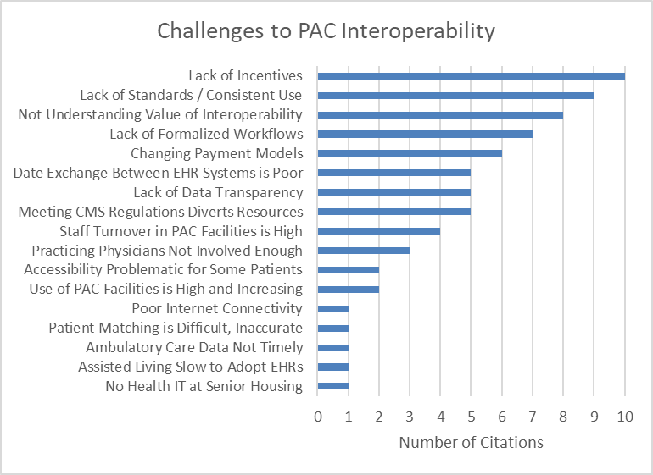
PAC Interoperability Challenges

Slide 17
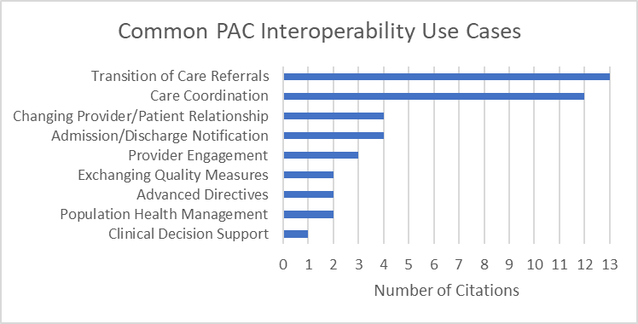
PAC Interoperability Use Cases

Slide 18

PACIO Project
The PACIO Project is a collaborative effort to advance interoperable health data exchange
between post-acute care providers, patients, and other key stakeholders.
http://pacioproject.org

Slide 19





PACIO Project Use Cases
Functional Status Use Case
Cognitive Status Use Case
Patient / Provider
Under Development:
FHIR Implementation Guide
Reference Implementation
Care Setting
Care Setting
Data Element Library
Assessments
http://pacioproject.org

Slide 20
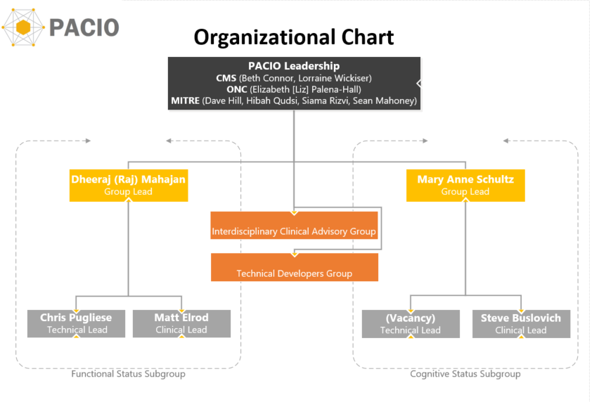
PACIO Project Organization
20

Slide 21
HL7 Connectathon (Data Element Library)
Track Proposal
https://confluence.hl7.org/display/FHIR/2019-09+Post-Acute+Care
Implementation Guide
https://paciowg.github.io/del/
Reference Implementation
Server: https://github.com/paciowg/del
Client: https://github.com/paciowg/delDemo
Test Scripts: https://github.com/paciowg/inferno
http://pacioproject.org

Slide 22
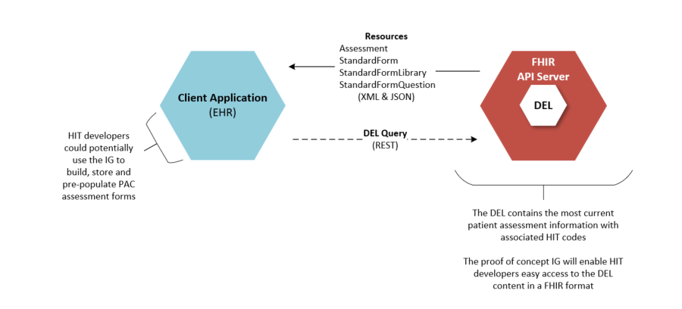
Data Element Library Reference Implementation Components
http://pacioproject.org

Slide 23
Changing Landscape: Where is PAC?
Payment Changes
Emerging Models
Primary Care First
Analytics, Tools & Measures
Frailty Index
Data Sharing
Quality Measures
PDPM
ACOs
BPCI Advanced
I-SNPs
PDGM
Care Coordination
Transition of Care
PACIO Project

Slide 24
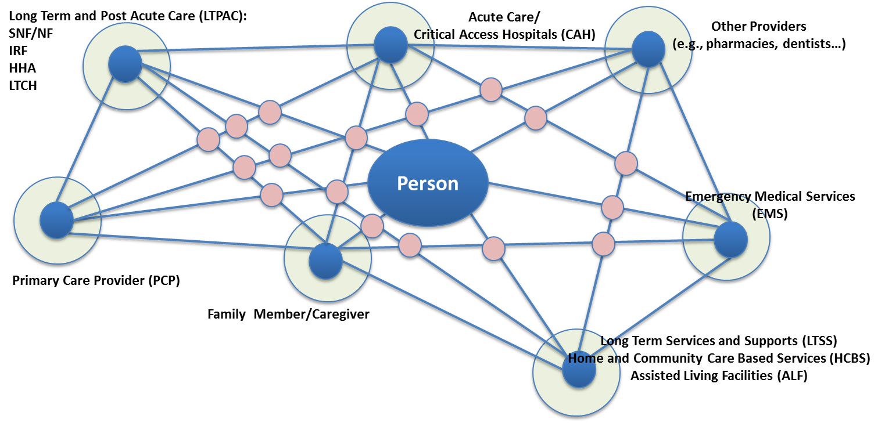
Data Availability and Real-time Exchange
Support data availability in real-time. Electronic information is exchanged and used by health IT systems without special effort on the part of the user.

Slide 25
Call to Action: How to Participate
Health IT developers
Build on existing health IT systems
Try out new projects/systems
Providers
Analyze how and where assessment data fits in clinical workflow
Provide feedback on development priorities
Ways to contribute:
Subject matter expertise
Scalability of implementing the eventual solution
Assist in the delivery of key deliverables and project artifacts
Development of testing tools, testing implementations, etc.

Slide 26
How to Participate: Interoperability
PACIO Project
Visit http://pacioproject.org
Contact info@pacioproject.org
HL7 Connectathon (September 14-15, Atlanta, GA)
Select the Post-Acute Care track
Reach out to the track lead via Zulip
https://chat.fhir.org
Get your system(s) ready to interact with others
Bring your FHIR knowledge and development tools

Slide 27

Wrap Up and Q&A

Slide 28
Resources
For more information on the IMPACT Act, visit the IMPACT Act webpage
For more information on Post-Acute Care Quality Reporting Programs, visit:
Home Health Agencies
Hospice Agencies
Inpatient Rehab Facilities
Long-term Care Hospitals
Skilled Nursing Facilities
For DEL updates, sign up for the listserv here
For DEL feedback or questions, contact: DELHelp@cms.hhs.gov
For PACIO information, please visit: http://pacioproject.org/

Slide 29
Medicaid Technology Financing to Support Health Information Exchange Activities
CMS Incentive through State Medicaid Director Letter (#16-003)
Medicaid HITECH funds are now available to support states in their initiatives to expand interoperability and data sharing related to connecting professionals and hospitals that are eligible for Medicaid EHR Incentive Payments to other Medicaid providers, including behavioral health, long-term care providers (including nursing facilities), home health providers, and other Medicaid providers, including community-based Medicaid providers.
This funding is in place until 2021 and is a 90/10 Federal State match. The state is still responsible for providing the 10%.
The funding is for HIE and interoperability only, not to provide EHRs.
The funding is for implementation only, it is not for operational costs.
The funding still must be cost allocated if other entities than the state Medicaid agency benefit
All providers or systems supported by this funding must connect to Medicaid Eligible Providers
For more information: https://www.medicaid.gov/federalpolicyguidance/downloads/smd16003.pdf

Slide 30

Thank You
Beth Connor, CMS
Beth.Connor@cms.hhs.gov
Dave Hill, MITRE
Dwhill@mitre.org
Dheeraj Mahajan, MD, MBA, MPH, FACP
dm@cimpar.com
Michelle Dougherty, RTI International
MDougherty@rti.org
@mvldougherty

